Slide 1

2Market overview
YOUKO FUJINO
18.12.2023
Consumer Profile, Countries Purchase Patterns and Ad Efficiency

Slide 2

AGENDA
Countries Contribution to Sales
Customer Profile
Online Sales Across Countries
And Ad Efficiency

Slide 3
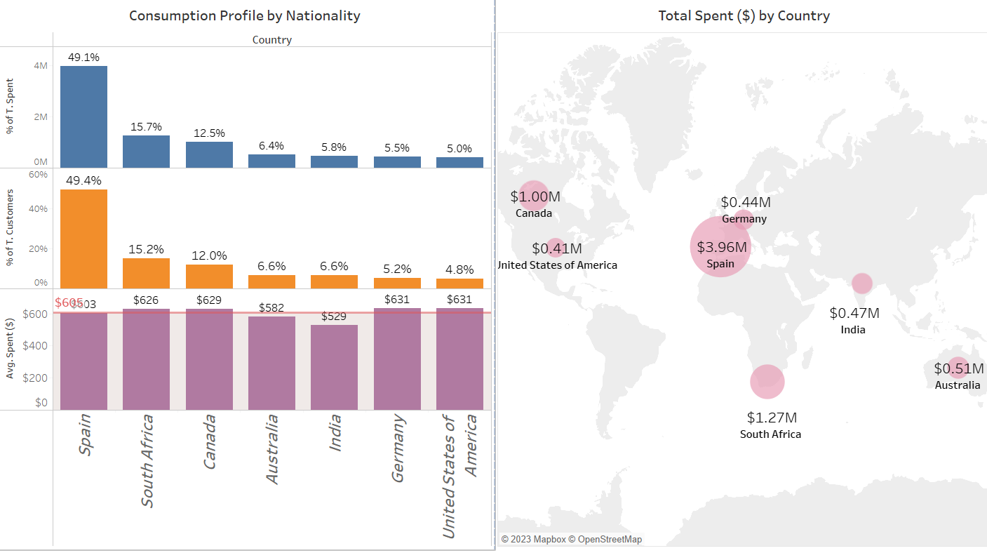
SPAIN ALONE MAKES up ALMOST HALF OF 2MARKET SALES AND CONSUMER PANEL
Top Countries
by $ Spend and
Consumer Panel Representation:
Spain
South Africa
Canada
Potential Markets
(Avg Spend)
US
Germany
US and GE are high-potential markets, with avg spend above the global avg.
*Mexico is a very incipient market (0.2% of Total Spend) with a high average spend ($1.041). Therefore, we took it out of this average calculation.
Countries Contribution to Sales

Slide 4
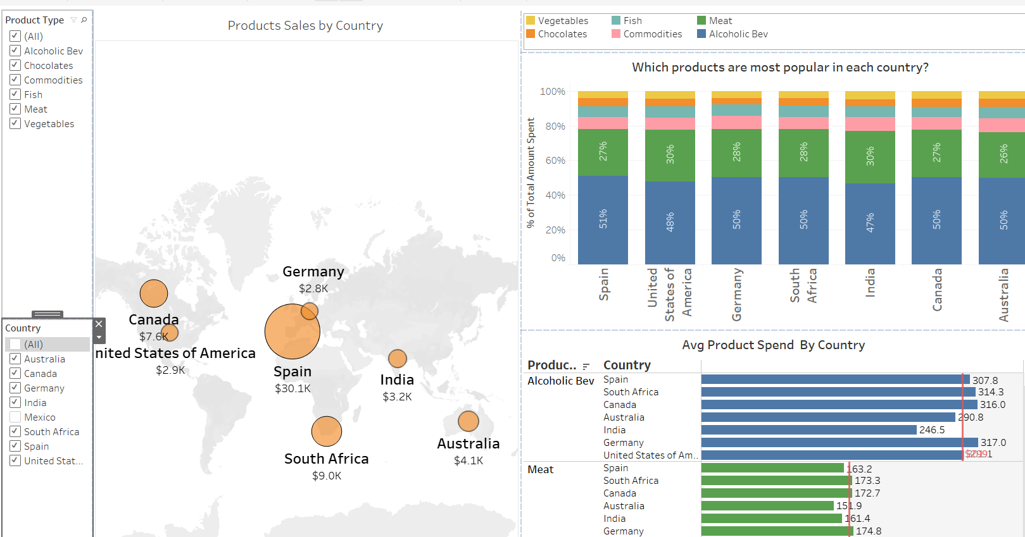
ALCOHOLIC BEVerages MAKE HALF OF SALES ACROSS COUNTRIES, FOLLOWED BY MEAT
Top Products
by $ Spend
Alcoholic Beverages
Meat Items
Commodities
Room to Grow based on Avg Country Spend and Product Spend
Canada: Meat
2. Commodities: Spain
Top Countries (SP, SA,CA) plus Germany are the top consumers of Alcoholic Beverages.
Potential to develop meat items in Canada as it is a high-spend market.
Countries Contribution to Sales

Slide 5
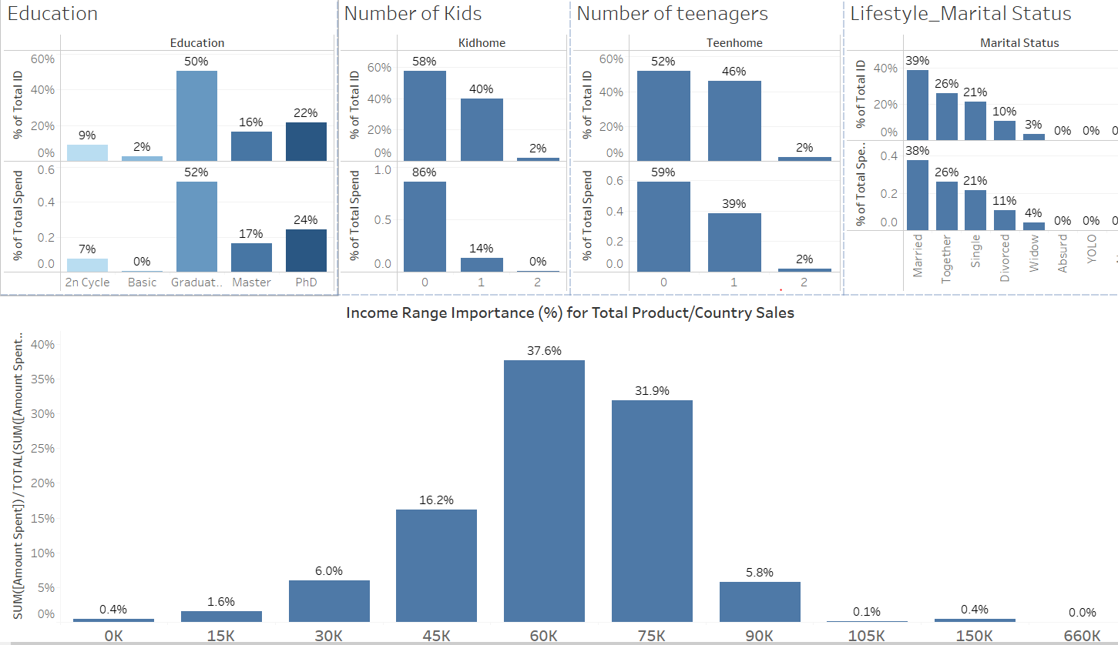
2 markets consumers are mature , graduated, with no kids and income ranging from 45-75k
1) Graduated with a Bsc degree (50%)
2) With no children at home (58%) and no teens (52%).
However, a significant portion of consumers with one child or one teen
3) Mainly Married or Together
4) Income ranging from
45k-75k
5) Avg Age of 57 years, with mature consumers (50-70 yo) making more than 70% of their samples
2. Customer Profile

Slide 6
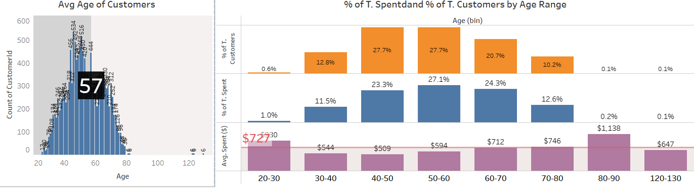
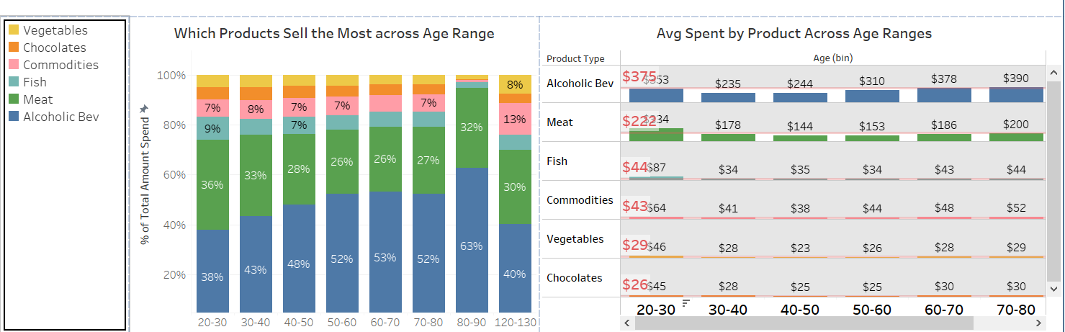
mature consumers (40-70 yo) make more than 80% of 2market consumer panel
Avg Age of
57 years.
Alcohol consumption appears to increase as people age.
The opposite for Meat.
2. Customer Profile

Slide 7
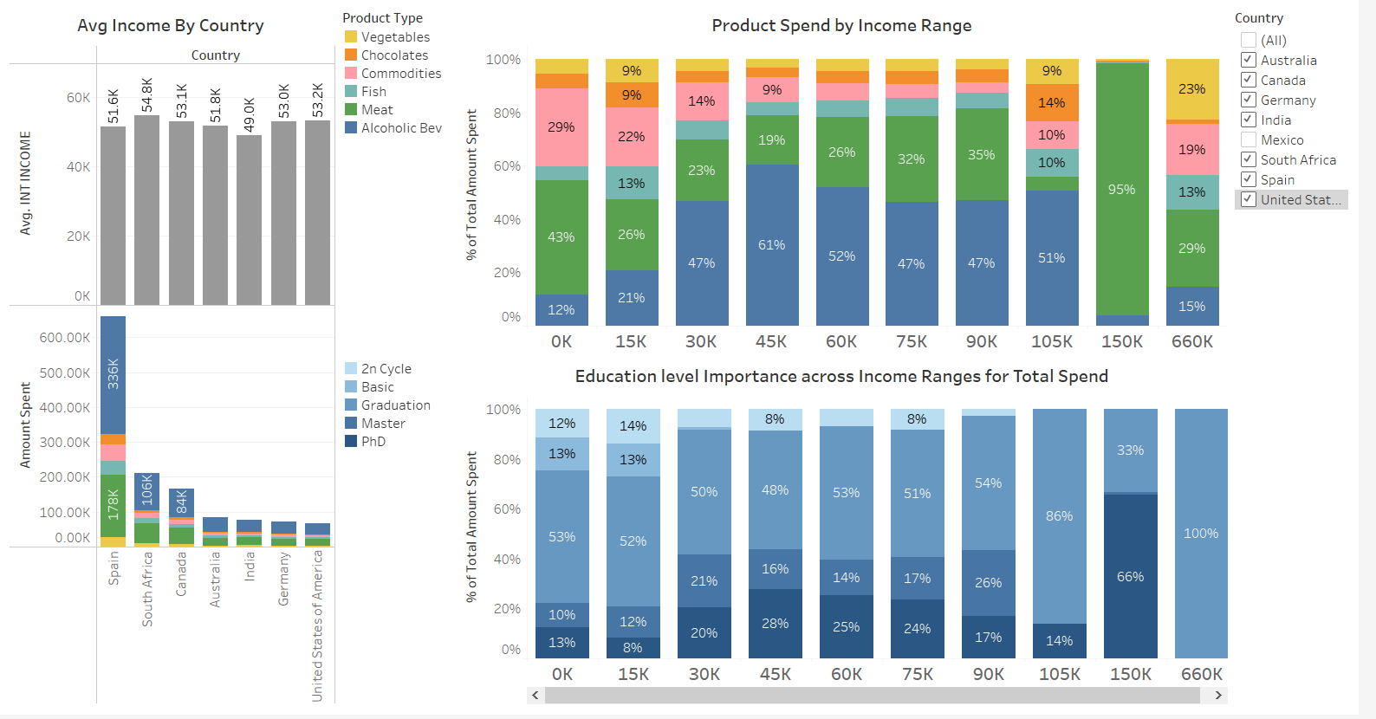
DESPITE SPAIN occupying the #1 position in SPEND by COUNTRY, IT IS NOT AMONG THE TOP 3 COUNTRIES BY AVG INCOME: SA, US, CA
Top Contries
by $ Income
South Africa
United States
Canada
Top Countries
by $ Spend and
Consumer Panel Representation:
Spain
South Africa
Canada
Alcohol and Meat Consumption increase with income progression
2. Customer Profile

Slide 8
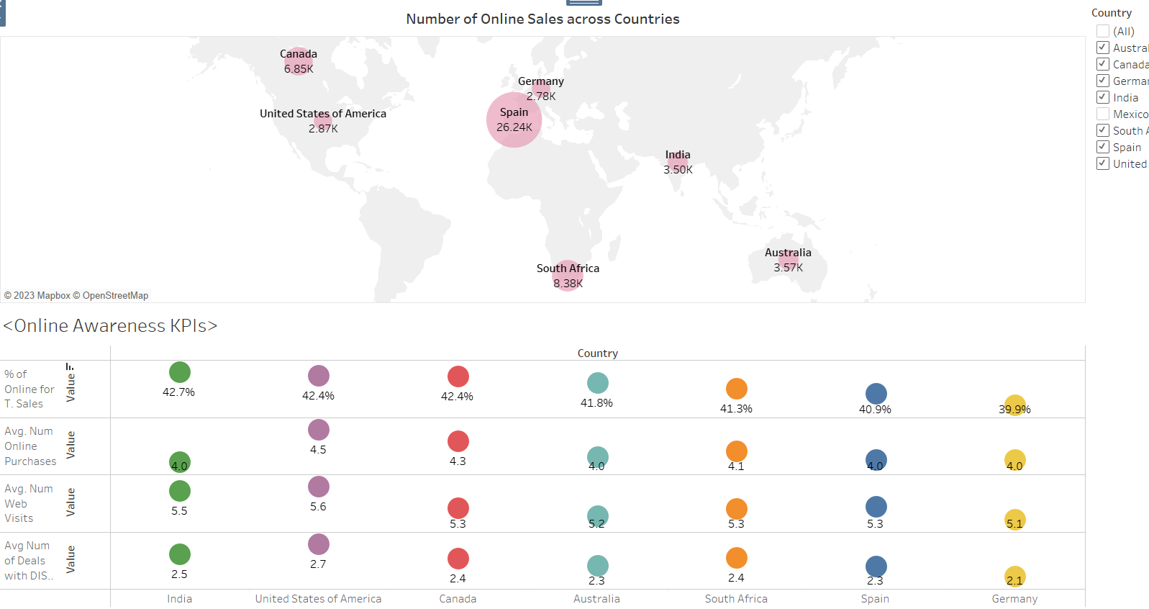
INDIA, CANADA AND US SHOW THE HIGHEST IMPORTANCE OF ONLINE TO THEIR TOTAL SALES
Top Countries
by Number of Online Sales
Spain
South Africa
Canada
Top Countries
by $ Spend and
Consumer Panel :
Spain
South Africa
Canada
Top Countries
by Importance of Online(%):
India
Canada
US
However, in Avg Number of Online Purchases, US and Canada led the rank as India doesn’t achieve the same scale of overall sales yet.
3. Online Sales Across Countries

Slide 9
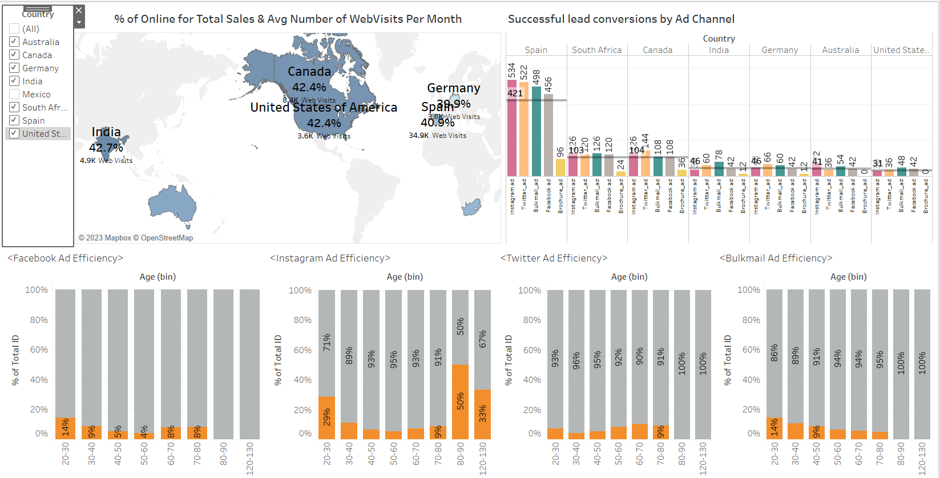
INSTAGRAM AND TWITTER ARE THE MOST EFFICIENT AD CHANNELS WITH HIGHER COVERSION AMONG MATURE CONSUMERS
3. Ad Efficiency

Slide 10



KEY FINDINGS
COUNTRIES
PERFORMANCE
CONSUMER
PROFILE
ONLINE AND
AD BEHAVIOUR
Spain alone makes up almost half of the 2market sales and consumer panel.
Despite Spain being a top spend country, it is not among the top 3 countries by average income: SA, US, CA
Top countries by $ spend and
Consumer panel representation:
Spain
South africa
Canada
Potential markets
(Avg spend)
Us
Germany
2 Market Consumers Are Mature Consumers, Graduated, With No Kids And Income Ranging From 45-75k
2 Market Consumers are in overall:
1) Graduated with a Bsc degree (50%)
2) With no children at home (58%) and no teens (52%).
However, a significant portion of consumers with one child or one teen
3) Mainly Married or Together
4) Income ranging from
45k-75k
5) Avg Age of 57 years, with mature consumers (50-70 yo) making more than 70% of their samples
India, Canada and United States of America show the highest importance of online to their total sales.
Instagram and Twitter are the most efficient ad channels with higher conversion among mature consumers.
Top countries
By number of online sales
Spain
South Africa
Canada
Top countries
By $ spend and Consumer panel :
Spain
South Africa
Canada
Top countries
By importance of online(%):
India
Canada
United States

Slide 11
THANK YOU
WOODGROVE BANK

